Slide 1
Chapter 1
Introduction to electrodynamics

Slide 2
Contents
Introduction
The laws of EM
Covariance
Unification
Standard references

Slide 3
Contents
Appendix
Metric and units
Index notation
Analogy

Slide 4
1. Introduction
1.1 Applications
1.2 Fundamental interactions

Slide 5
Name 3 applications
Preferably involving different laws of EM

Slide 6
1. Introduction
1.1 Applications
1.2 Fundamental interactions

Slide 7
EM is the best understood of fundamental interactions
Leads to many concepts at the core of theoretical physics

Slide 8
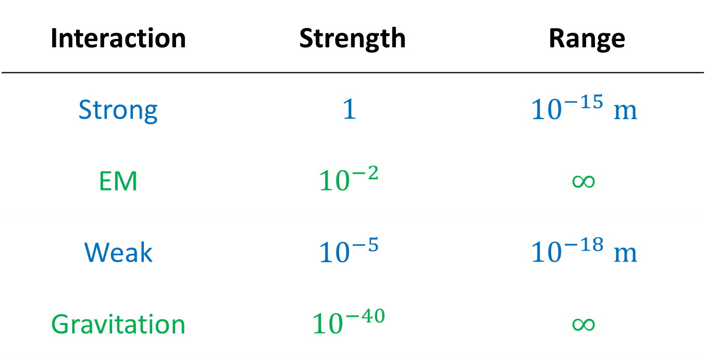
Interaction | Strength | Range
Strong | $$1$$ | $${10}^{−15} m$$
EM | $${10}^{−2}$$ | $$∞$$
Weak | $${10}^{−5}$$ | $${10}^{−18} m$$
Gravitation | $${10}^{−40}$$ | $$∞$$

Slide 9
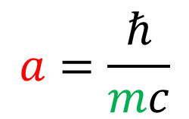
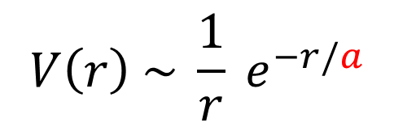


Range of interaction
$$V\left(r\right) \sim \frac{1}{r} e^{−r/a}$$
Yukawa
$$a=\frac{ℏ}{mc}$$
$$m$$
EM
photon
$$m=0$$
Gravitation
graviton

Slide 10

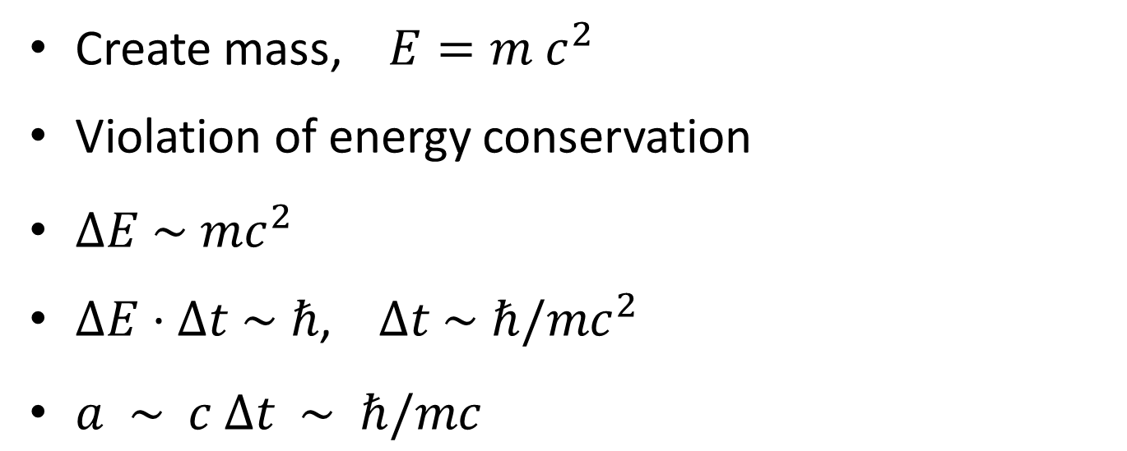
$$m$$
Create mass, $E=m c^{2}$
Violation of energy conservation
$ΔE \sim mc^{2}$
$ΔE⋅Δt \sim ℏ$, $Δt \sim ℏ/mc^{2}$
$a \sim c Δt \sim ℏ/mc$

Slide 11
EM
EM waves
photons
Gravity
Gravitational waves
gravitons
??
LIGO 2016

Slide 12
Range and classical physics

Slide 13
2. Laws of EM
2.1 Two sides to electrodynamics
2.2 Lorentz force law
2.3 Maxwell’s equations
2.4 Different vectors

Slide 14
Lorentz force law
Matter
(charge + current)
Fields
Maxwell’s equation

Slide 15
2. Laws of EM
2.1 Two sides to electrodynamics
2.2 Lorentz force law
2.3 Maxwell’s equations
2.4 Different vectors

Slide 16
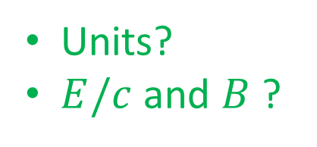


Force on point charge
$$F=q(E+v×B)$$
Units?
$E/c$ and $B$ ?
Force on current
$$F=I Δl ×B$$

Slide 17
2. Laws of EM
2.1 Two sides to electrodynamics
2.2 Lorentz force law
2.3 Maxwell’s equations
2.4 Different vectors

Slide 18


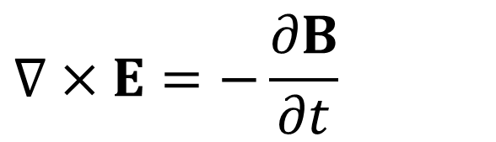
$$∇⋅E=\frac{ρ}{ε_{0}}$$
$$∇×E=−\frac{∂B}{∂t}$$
$$∇⋅B=0$$
$$∇×B=μ_{0}J+ε_{0}μ_{0}\frac{∂E}{∂t}$$
Notes:
File: 01-ED001-v07
Slide: 17
Remove the dot in the final line

Slide 19




Perspective 1
$$∇⋅E= ?$$
$$∇×E= ?$$
$$∇⋅B= ?$$
$$∇×B= ?$$

Slide 20
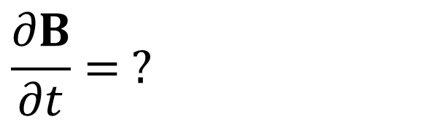
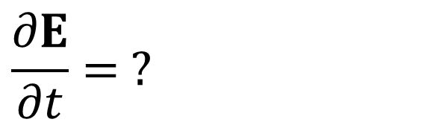
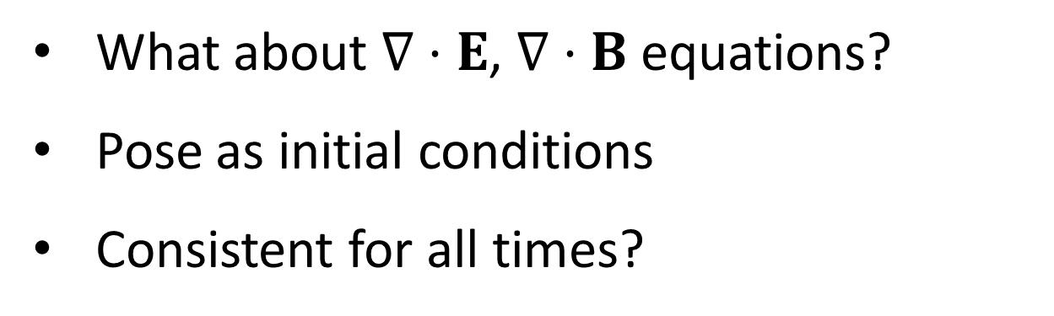
Perspective 2
$$\frac{∂E}{∂t}= ?$$
$$\frac{∂B}{∂t}= ?$$
for initial value problems
What about $∇⋅E$, $∇⋅B$ equations?
Pose as initial conditions
Consistent for all times?

Slide 21


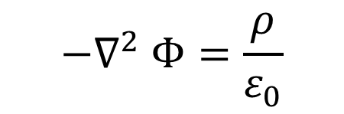


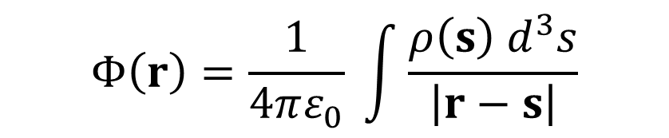
Perspective 3: Potentials
Electrostatics
General
$$−∇^{2} Φ=\frac{ρ}{ε_{0}}$$
$$DA \sim J$$
$$Φ\left(r\right)=\frac{1}{4πε_{0}} \int{\frac{ρ\left(s\right) d^{3}s}{\left|r−s\right|}}$$
$$Φ \sim G ρ$$
$$A \sim G J$$
$$G=D^{−1}$$

Slide 22
2. Laws of EM
2.1 Two sides to electrodynamics
2.2 Lorentz force law
2.3 Maxwell’s equations
2.4 Different vectors

Slide 23




$$D=ε_{0} E$$
$$+ …$$
$$H=μ_{0}^{−1} B$$
$$+ …$$
when material is present

Slide 24
3. Covariance

Slide 25
There is no preferred frame
All physical phenomena can be explained by the same laws of physics in any frame

Slide 26

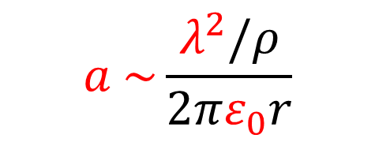


Example
mass $= ρl$, charge $=λ l$
$$r$$
$$a= ?$$
$$a \sim \frac{λ^{2}/ρ}{2πε_{0}r}$$

Slide 27
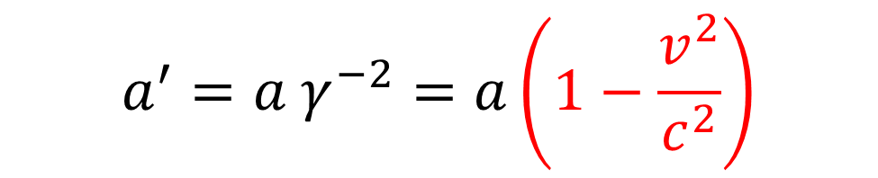
Go to moving frame
$$a^{′}=a γ^{−2}=a\left(1−\frac{v^{2}}{c^{2}}\right)$$
Lorentz transformation

Slide 28


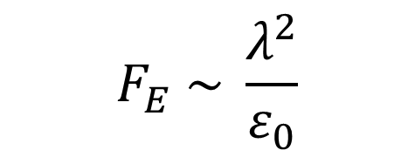



Solve directly for moving wires
mass $= ρl$, charge $=λ l$
$$v$$
$$v$$
$$r$$
$$F_{E} \sim \frac{λ^{2}}{ε_{0}}$$
$$F_{M} \sim −μ_{0} λ^{2} v^{2}$$
$$F \sim \frac{λ^{2}}{ε_{0}}\left(1−μ_{0}ε_{0}v^{2}\right)$$

Slide 29

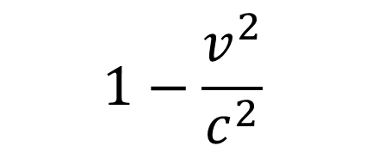

Compare
$$1−\frac{v^{2}}{c^{2}}$$
$$1−μ_{0}ε_{0}v^{2}$$
$$μ_{0}ε_{0}=c^{−2}$$

Slide 30
Involve many laws of EM: consistent
Did not use time-dependent Maxwell equations, did not solve for wave solutions
Showed one phenomenon consistently described
How do we deal with all phenomena?
Examine laws

Slide 31
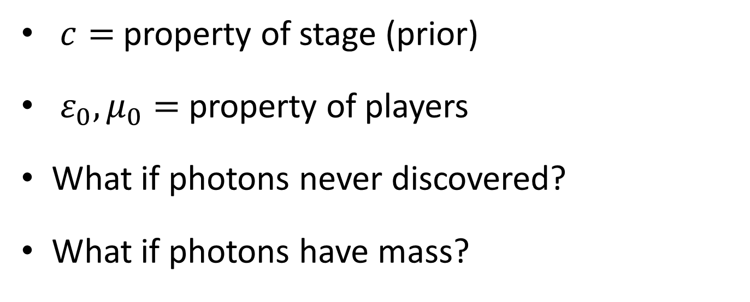
Velocity of light
The “velocity of light” need not have anything to do with light!
$c=$ property of stage (prior)
$ε_{0}, μ_{0}=$ property of players
What if photons never discovered?
What if photons have mass?

Slide 32
4. Unification

Slide 33
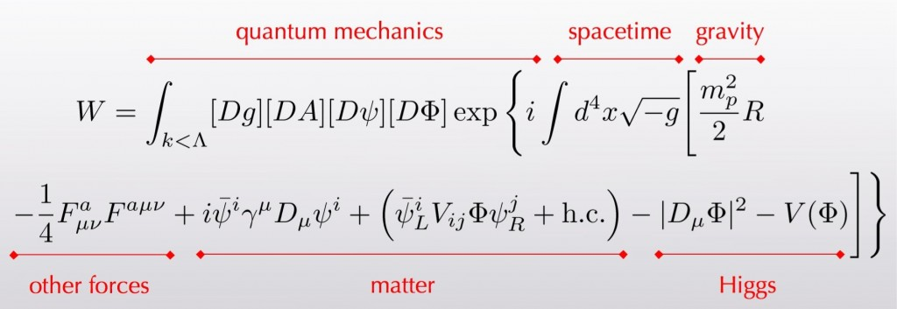
Physics in one equation
QM = path integral over exp (iS)
S is integral over Lagrangian density
Gauge fields including EM
Replace derivative with covariant derivative

Slide 34
5. Standard references

Slide 35
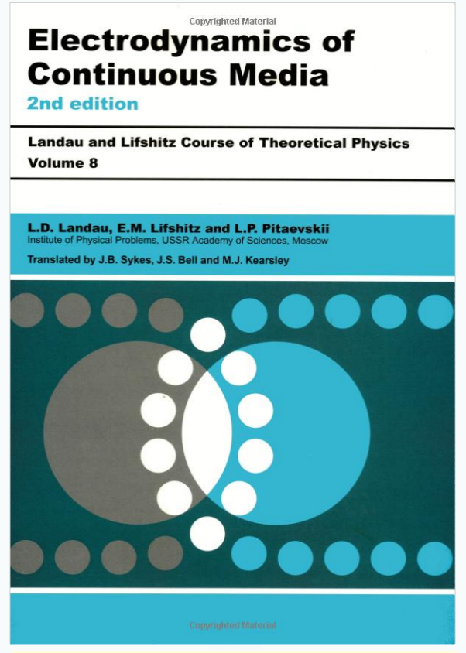
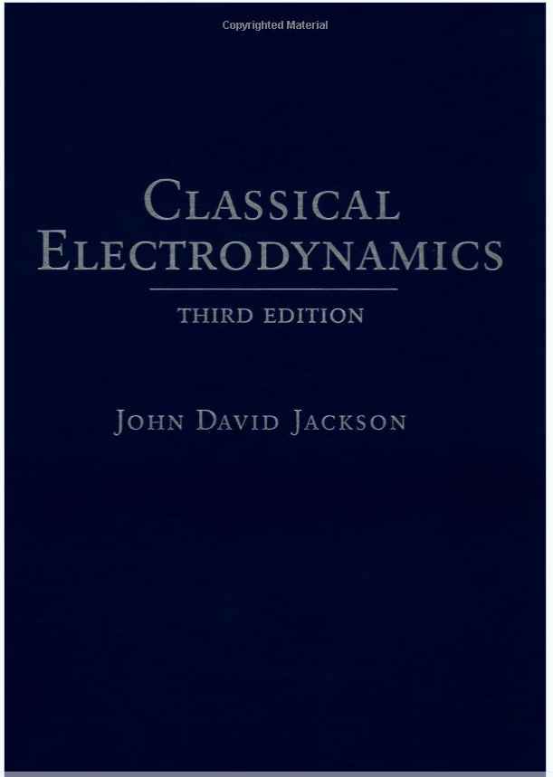
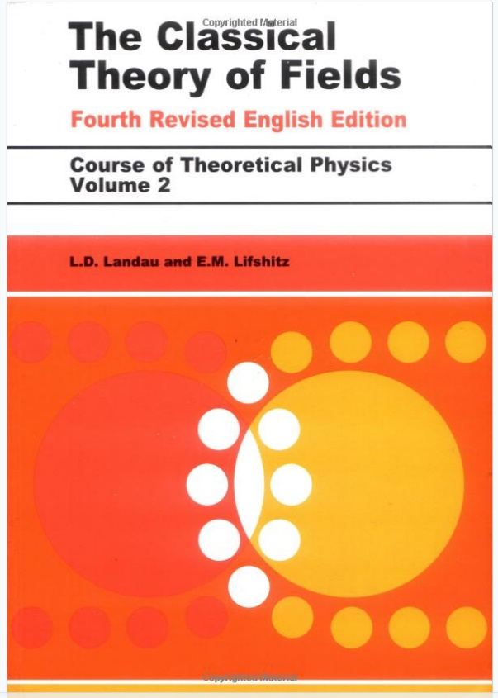
Book covers extracted from amazon preview

Slide 36
A. Metric and units

Slide 37
B. Index notation

Slide 38
C. Analogy

Slide 39





$$y=11.0$$
$$z=5.9$$
$$M$$
$$E$$
stage
$$x=y+z=16.9$$

Slide 40



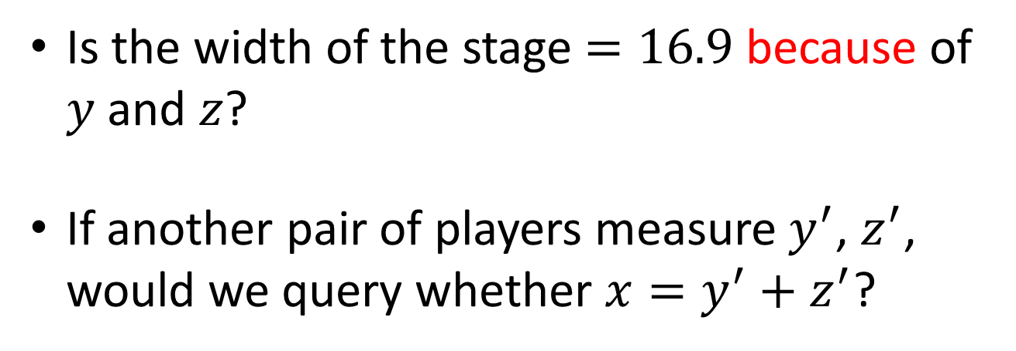
$$x=y+z$$
$$16.9=11.0+5.9$$
Is the width of the stage $=16.9$ because of $y$ and $z$?
If another pair of players measure $y^{′}$, $z^{′}$, would we query whether $x=y^{′}+z^{′}$?
$$\log{c^{2}}=\log{ε_{0}^{−1}}+\log{μ_{0}^{−1}}$$

